Slide 1
SWE30003 Software Architectures and Design
Lecture 2 User Tasks, Goal-Design Scale

Slide 2
Logistical matters
Announcements/reminders:
Assignment 1 spec to be released today after the lecture
Weekly submissions – A & Q:
Week 2: 104 & 101 out of 119;
Week 3: …
Note that this is a hurdle requirement
No late submission

Slide 3
Question to Answer from Week 1
In your own words, characterize the difference between verification and validation and discuss where in the software development lifecycle (SDLC) verification and validation activities should be conducted, respectively.
----------
Major SDLC activities: Requirements elicitation and analysis, design, implementation, testing, maintenance.
Notes:
I need to talk about this in a bit more detail…
There was quite a bit of confusion and misconceptions about the SDLC … ☹

Slide 4
Activities in Software Development
Project Inception
Prototyping
Validation
Elicitation
Design
SDLC model defines order and repetition.
Testing
Analysis
Maintenance
Coding
Deployment
Phase Out
Notes:
Needs some explanation here… this is in essence a software development perspective!

Slide 5
Principal References
Soren Lauesen, Software Requirements: Styles and Techniques, Addison-Wesley, 2002, Chapters 1 to 3.
Soren Lauesen, Task Descriptions as Functional Requirements, IEEE Software, March 2003, (available as PDF from Canvas).

Slide 6
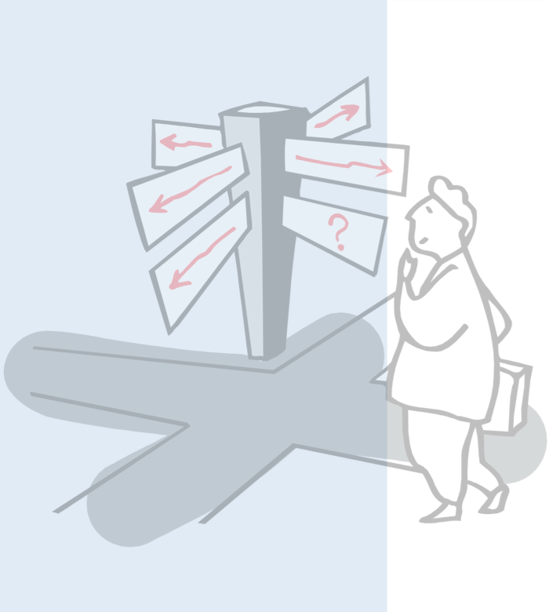
Outline
Requirements
Requirements Engineering Process / Activities
Types of Requirements
Scenarios and Use Cases
Goal-Design Scale
Domain Model and Data Requirements
Functional Requirements and Task Description

Slide 7
The Role of Requirements
Stakeholders
Tacit
demands
& reqs
Demands
Elicitation
Analysis
Contract
Reqspec
Validation
Design
Tracing:
Forwards . . .
Backwards . . .
Requirements management:
Changing requirements
Program
Verification
Test
Op & maint
Notes:
This slide needs quite a bit of discussion. Worth mentioning what tacit requirements are…

Slide 8
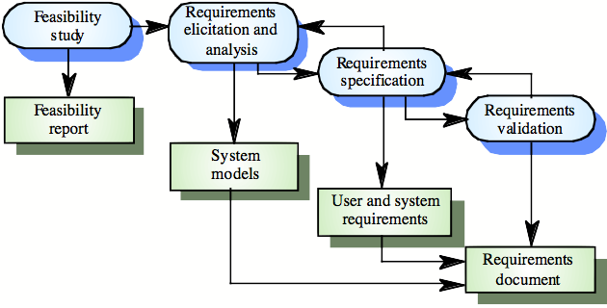
The Requirements Engineering Process
© Ian Sommerville 2000
© Oscar Nierstrasz
Notes:
Ch6 p 122

Slide 9
Requirements Engineering Activities
Feasibility study | Determine if the user needs can be satisfied with the available technology and budget.
Requirements elicitation | Find out what system stakeholders require from the system.
Requirements analysis | Clarify/define/document the requirements in a form understandable to the customer.
Requirements specification | Define the requirements in detail. (Written as a contract between client and contractor.)
“Requirements are for users; specifications are for analysts and developers.”
Notes:
Requirements analysis is also about “making sense” what the elicitation has uncovered!
… and then there is the whole legal side of contracts…

Slide 10
Requirements Elicitation
Sometimes called requirements discovery.
Expert staff work with customers to determine
the application domain,
the services (functionality and quality) that the system must provide, and
the system’s operational constraints.
Involves various stakeholders:
e.g., end-users, managers, engineers involved in maintenance, domain experts, trade unions, etc.
Notes:
Make a comment about “should” vs. “must”…

Slide 11
Elicitation Example: Library System
Scenario: University wants a new online library catalogue system.
Elicitor interviews stakeholders to uncover domain, services, and constraints:
Stakeholder | Method | Key Requirement | Type
Student (end-user) | Interview | Search books by title, author, or subject | Functional
Librarian (admin) | Workshop | Add, edit, and remove catalogue entries | Functional
IT Manager | Questionnaire | System uptime ≥ 99.5%; response < 2 sec | Non-functional
Accessibility Officer | Observation | Screen-reader compatible; WCAG 2.1 AA | Constraint
University Legal Dept. | Document review | Comply with copyright and data privacy law | Constraint
Notes:
Make a comment about “should” vs. “must”…

Slide 12
Requirements Analysis
Requires collaboration of people with different backgrounds
Users with application domain knowledge
Developers with implementation domain knowledge
Bridging the gap between users and developers:
Scenarios: Example of the use of the system in terms of a series of interactions between the user and the system
Use cases: Abstraction that describes a class of scenarios
User tasks: Generalizations of different kind of use cases
Workflows: Interdependencies between various user tasks
…
Notes:
RE is a challenging activity because of need to communicate. The developer will need to learn the jargon of the application domain.
Example of domain knowledge – curtain quoting need to know about swags and drops and patterns.
Also user may not be able to express a clear idea of what is wanted from the computer.
A scenario is a real-life example of interactions between one or more actors and the system.
Bruegge p.108: A scenario is a concrete, focused, informal description of a single feature of the system from the viewpoint of a single actor.
A scenario is an instance of a use case .. abstract from the concrete informal description
Example of scenario and use case

Slide 13
Requirements Analysis Phase
STAKEHOLDERS
⚙ Requirements Analysis
OUTPUTS
👤
Clients / End Users
📄
Software Requirements Spec
1
Elicitation
Interviews, workshops, observation
📊
Business Analysts
2
Classification
📝
Use Cases & User Stories
Functional vs Non-functional constraints
3
Conflict Resolution
🔬
Domain Experts
Prioritise & negotiate stakeholder needs
⚡
Non-Functional Requirements
4
Prioritisation
MoSCoW, value vs effort ranking
📋
Project Managers
Documentation
📌
Prioritised Backlog
5
SRS, Use Cases, User Stories
💡 Key insight: Requirements Analysis bridges the gap between what stakeholders WANT and what developers BUILD.

Slide 14
But what types of requirements do exist?
Functional vs. non-functional is only one (coarse-grained) way to distinguish requirements.

Slide 15
Types of Requirements
Quality reqs:
Performance
Usability
Maintainability
. . .
Other deliverables:
Documentation
Install, convert,
train . . .
Interfaces
User
groups
Platform:
Hardware, O/S
Sensors, Actuators
System
No Size Fits All!
Ext. products:
3rd Party Software, Database
Data requirements:
System state: Common states,
Input/output formats, Persistent Data
Managerial reqs:
Delivery time
Legal
Development
process . . .
Helping the reader:
Business goals
Definitions
Diagrams . . .
Functional requirements, each interface:
Record, compute, transform, transmit
Theory: F(input, state) -> (output, state)
Function list, pseudo code, activity diagrams
Screen prototypes, user tasks
Notes:
This slide probably needs quite a bit of explanation…
Data requirements should remain as abstract as possible… otherwise, we are specifying a solution already…

Slide 16
Traditional “feature” requirements
Roster planning, Midland Hospital
R47. It must be possible to attach a duty type code (first duty, end duty, etc.) to the individual employee.
R475. The system must be able to calculate the financial consequences of a given duty roster - in hours and in money terms.
R479. The system must give notice if a duty roster implies use of a temporary worker for more than three months.
R669. The system must give understandable messages in text form in the event of errors, and instruct the user on what to do.
What is “wrong” with these kinds of requirements?
Notes:
We can discuss these requirements in quite some detail… task for the ‘user’ to write them up in a better way…

Slide 17
Outline
Requirements
Requirements Engineering Process / Activities
Types of Requirements
Scenarios and Use Cases
Goal-Design Scale
Domain Model and Data Requirements
Functional Requirements and Task Description

Slide 18
Users Perspective
Users often tend to think about systems in terms of “features”
E.g., “the system must provide a function to do X”
Get users to tell you stories involving those features.
How do users anticipate these features to be used in combination with other features.
Scenarios and Use cases can assist in order to get requirements complete and consistent!

Slide 19
Scenarios
Users interact with a computer systems to complete a “task” (or) achieve a “goal” (or have some fun…)
These interactions can be captured as a set of scenarios (or) stories
Example: “Buy a product” scenario for an online store:
Mary browses the catalogue and adds desired items (chocolate) to the shopping basket. When she has finished shopping, Mary provides her address for delivery, credit card information and then confirms the transaction. The system confirms her payment and e-mails a transaction record.
Notes:
19
Note that scenarios give you “context”, but not necessarily fully complete requirements…

Slide 20
Scenarios (cont.)
In the “Buy a product” scenario we covered the normal ideal interaction between a user and “the system”. But
What happens if the credit-card payment fails?
What if the customer is a repeat customer, so shipping details are already in the system?
The key scenario would hold, but to answer the above questions we have to add alternative scenarios.
Scenarios can also be written down as a series of steps
Identify different scenarios that can be written up
Notes:
20
Main success scenario

Slide 21
Use Case
If we structure scenarios, they can represent the behavioural requirements of the system – from a user’s view point.
“A use case is a set of scenarios tied together by a common user goal” – Martin Fowler
Every use case must be tied to a specific goal
A use case is directly or indirectly invoked by an actor
“A use case is the specification of a sequence of actions, including variants, that a system (or other entity) can perform, interacting with actors of the system.”
Notes:
21

Slide 22
Actors
An actor is a role that a user plays when interacting with the system.
An actor performs a Use Case.
A single actor may perform many use cases
A use case may have several actors performing it
Actors do not need to be human
Can be an external system
Can be a device (e.g., temperature probe)
Notes:
22

Slide 23
But…
Use cases and scenarios are still too much focused on the “solution domain” instead of identifying the real problem to be addressed.
→The “Tasks & Support” approach …

Slide 24
Outline
Requirements
Requirements Engineering Process / Activities
Types of Requirements
Scenarios and Use Cases
Goal-Design Scale
Domain Model and Data Requirements
Functional Requirements and Task Description

Slide 25
Domain and Product Levels
“Business” domain
Inner Domain
Actors?
Platform
Clients
Product
User
activities
Control
computers
Domain
I/O
Product
I/O
Elevators
Domain-level requirements:
The product shall support
the following user activities: . . .
Product-level requirements:
The product shall accept
the following input: . . .
Notes:
Note: this gives room to quite a few discussions!

Slide 26
The Goal-Design Scale
Goal level requirements specify business goals.
Domain level requirements specify the activities that go on outside the product (i.e. in the domain).
Product level requirements specify what should come in and out of the product.
Design level requirements specify user-interface details and internals of the system.
Notes:
This is something we definitely need to talk about in more detail!
Also, these four levels are very important and have been known to be part of exam questions!

Slide 27
The Goal-Design Scale (cont.)
(Ship repair quotation system)
R1. Our pre-calculations shall hit within 5%
R2. Product shall support cost recording and quotation with experience data
R3. Product shall have recording and retrieval functions for experience data
R4. System shall have screen pictures as shown in app. xx
Goal-level
requirement
Domain-level
requirement
Product-level
requirement
Design-level
requirement
Which requirement to choose?
If the supplier is
A vendor of business applications?
A software house - programmers?
PriceWaterhouseCoopers?
Notes:
… and maybe it is worth noting “traceability” here…

Slide 28
Example: Hotel Information System
Tasks:
Book guest
Check in
Check out
Change room
Breakfast list &
other services
Data:
Guests
Rooms
Services
From: Soren Lauesen: Software Requirements
© Pearson / Addison-Wesley 2002

Slide 29
BREAK

Slide 30
Outline
Requirements
Requirements Engineering Process / Activities
Types of Requirements
Scenarios and Use Cases
Goal-Design Scale
Domain Model and Data Requirements
Functional Requirements and Task Description

Slide 31
Recap - Domain Model Development
Process
Step 1. Perform a textual analysis of the problem specification for understanding the problem domain
Circle all nouns and underline the verbs
Step 2. Write down relevant domain entities. They are normally (some of) the nouns defined above.
Step 3. Revisit the specification to extract the associations
Step 4. Record associations with the corresponding domain entities.
Note: domain modeling is not design; it is merely a way to understand the abstract concepts relevant to the problem!
Notes:
This slide is taken from SDP… slightly modified!

Slide 32
Hotel Information System – Domain Model
The system shall store the following domain entities (NOT database entities):
Guest
Service
Service
Type
Stay
Room
State
Room
Notation used?
From: Soren Lauesen: Software Requirements
© Pearson / Addison-Wesley 2002
Notes:
Note: these are entities in the domain, NOT database entities (or similar). They are there to capture essential relationships in the domain, not to (prematurely) define database schemas…

Slide 33
Beware of solution specifications! … too far
The system shall store the following domain entities:
name,
address1,
address2,
address3,
passport
Guest
name, price
Stay
Service
Service
Type
stay#,
paymethod,
employee
date, count
Room
State
date, #persons,
state (booked|occupied|repair)
room#,
#beds, type
price1, price2
Room
From: Soren Lauesen: Software Requirements
© Pearson / Addison-Wesley 2002
Notes:
This goes too far when it comes down to requirement analysis…

Slide 34
Outline
Requirements
Requirements Engineering Process / Activities
Types of Requirements
Scenarios and Use Cases
Goal-Design Scale
Domain Model and Data Requirements
Functional Requirements and Task Description

Slide 35
Task Descriptions
Task: 1.1 Booking
Purpose: Reserve room for a guest.
Work area: 1. Reception
Service guests - small and large issues. Normally standing. Frequent interrupts. Often alone, e.g. during night.
Users: Reception experience, IT novice.
R1: The product shall support tasks 1.1 to 1.5
Task: 1.2 Checkin
Purpose: Give guest a room. Mark it as
occupied. Start account.
Trigger/
Precondition: A guest arrives
Frequency: Average 0.5 checkins/room/day
Critical: Group tour with 50 guests.
Sub-tasks:
1. Find room
2. Record guest as checked in
3. Deliver key
Variants:
1a. Guest has booked in advance
1b. No suitable room
2a. Guest recorded at booking
2b. Regular customer
Missing
sub-task?
Task: 1.3 Checkout
Purpose: Release room, invoice guest.
. . .
From: Soren Lauesen: Software Requirements
© Pearson / Addison-Wesley 2002
Notes:
User tasks focus on activities that a user and “system” perform together… the distinction who does what is NOT made!

Slide 36
Tasks & Support
Task: 1.2 Checkin
Purpose: Give guest a room. Mark it . . .
Frequency: . . .
Sub-tasks:
1. Find room.
Problem: Guest wants neighbour rooms; price bargain.
2. Record guest as checked in.
3. Deliver key.
Problem: Guest forgets to return the key; guest wants two keys.
Variants:
1a. Guest has booked in advance.
Problem: Guest identification fuzzy.
Example solution:
System shows free rooms on floor maps. System shows bargain prices, time and day dependent.
(Standard data entry)
System prints electronic keys. New key for each customer.
System uses closest match algorithm.
Past:
Problems
Future:
Computer part
Domain
level
From: Soren Lauesen: Software Requirements © Pearson / Addison-Wesley 2002
Notes:
Need to emphasize what the example solution is for… Also, beware what terminology one uses… be generic, e.g., “authentication” vs. “log in”…

Slide 37
Use Cases vs. User Tasks
UML use case
diagram:
Hotel system
Booking
actor
Checkin
Receptionist
Checkout
Account
system
actor
Transfer
Human and computer separated:
Task descriptions. Split postponed:
Hotel system
Hotel system
Booking
Booking
Account
system
Transfer
. . .
. . .
From: Soren Lauesen: Software Requirements
© Pearson / Addison-Wesley 2002

Slide 38
Use Cases vs. User Tasks — Why We Split the Diagram
The hotel system UML diagram has ONE actor (Receptionist) connected to 4 use cases. Why split it into TWO diagrams?
BEFORE — Combined diagram (the problem)
Hotel System
⚠ Problem
Mixes what the human does
with what the computer does.
Hard to assign responsibilities!
Booking
Receptionist
Checkin
(Human)
Checkout
Account System
(Computer)
Transfer
✂ Split the diagram!
AFTER — Two focused diagrams (the solution)
User Task Diagram
Use Case Diagram (System)
🔑 Key Concept
User Task = what the
human does step-by-step
Use Case = how the
system responds to that
Splitting avoids mixing
responsibilities!
Booking
Booking
Receptionist
Checkin
Account Sys.
Transfer
Checkout
Checkout
📋 Human steps only — no system internals
💻 System interactions only — no human steps
Based on: Søren Lauesen, Software Requirements — Style and Techniques (Pearson/Addison-Wesley, 2002)

Slide 39
Postpone split whilst eliciting requirements!
Human and computer separated
Use case: Check in a booked guest
User action System action
Enter booking number
Show guest and booking details
Edit details (optional)
Store modifications
Push checkin
Allocate free room(s)
Display room number(s)
Give guest key(s)
From: Soren Lauesen: Software Requirements
© Pearson / Addison-Wesley 2002

Slide 40
Good vs. Bad Tasks
Good tasks:
• Closed: goal reached, pleasant feeling
• Session: Small, related tasks in one description
• Do not program!
Examples:
1 Manage rooms?
2 Book a guest?
3 Enter guest name?
4 Check in a bus of tourists
5 Stay at the hotel?
6 Change the guest’s address etc?
7 Change booking?
8 Cancel entire booking?
Frequent
mistake
Got them all?
• All events covered?
• Critical tasks covered?
• At least as good as before?
CRUD check
How to deal
with that?
From: Soren Lauesen: Software Requirements
© Pearson / Addison-Wesley 2002

Slide 41
Workflows
A workflow is a coherent representation of the (temporal) dependencies between the major steps of a process.
It primarily focuses on:
Actor(s) of each step
Dependencies between steps
Sequencing
Workflows assist in identifying high-level tasks and a sequence of “good” user tasks.
(client perspective ..)
Notes:
Workflows can help in identifying the steps of a process and, further, a list of suitable user tasks…

Slide 42
High-level Tasks
Task: 1. A stay at the hotel
Actor: The guest
Purpose: . . .
Sub-tasks:
1. Select a hotel.
Problem: We aren’t visible enough.
2. Booking.
Problem: Language and time zones. Guest wants two neighbor rooms
3. Check in.
Problem: Guests want two keys
4. Receive service
5. Check out
Problem: Long queue in the morning
6. Reimburse expenses
Problem: Private services on the bill
Example solution:
?
Web-booking.
Choose rooms on web at a fee.
Electronic keys.
Use electronic key for self- checkout.
Split into two invoices, e.g. through room TV.
From: Soren Lauesen: Software Requirements
© Pearson / Addison-Wesley 2002
Notes:
High-level tasks are a similar concept to work-flows…

Slide 43
Questions for Consideration
What is a drawback of using Task Descriptions over other styles of functional requirements? How could this be managed?
What is the difference between subtasks and variants when designing a Task Description?
Within a Task Description, what is the difference between a Trigger and a Precondition?
Task descriptions don’t cover quality requirements such as response time and usability, but they point out where quality is crucial. How does a task description point out quality requirements?
How do you relate the different task descriptions to different actors when using the Task and Support method? How is this relation shown when the same tasks are applicable to different users of the system?

Slide 44
Question to Answer - Week 2
Describe the difference between Use Case diagrams and Task Descriptions. What are the advantages of using Task Descriptions as opposed to User Cases? Provide a situation where Task Descriptions are more suitable for use than Use Case Diagrams.

Slide 45
Exercise for Week 3
Roster planning, Midland Hospital
R47. It must be possible to attach a duty type code (first duty, end duty, etc.) to the individual employee.
R475. The system must be able to calculate the financial consequences of a given duty roster - in hours and in money terms.
R479. The system must give notice if a duty roster implies use of a temporary worker for more than three months.
R669. The system must give understandable messages in text form in the event of errors, and instruct the user on what to do.
Using your own words, write these requirements up in a verifiable way!
Notes:
We can discuss these requirements in quite some detail… task for the ‘user’ to write them up in a better way…

Slide 46
Required Pre-Reading for Lecture 3
Len Bass, Paul Clements, and Rick Kazman, Software Architecture in Practice (4th Edition), Addison-Wesley, 2021, Chapter 3 (Understanding Quality Attributes). (Chapter 4 in the 3rd or 2nd Edition is a suitable replacement)
Ian Gorton, Essential Software Architecture, Springer, 2006, Chapter 3 (available from Canvas).
Note: the question to be submitted by next week are expected to come from one of these two chapters!

Slide 47
Assignment 1 SRS
An online Healthy Foods Store system
Things the client/store wants to achieve … “not clear enough” – deliberate …
Requirements elicitation and specification: role play, analysis, reasonable assumptions
Domain/data model: high level ER + explanation
Functional requirements: Tasks&Support + explanation
Non-functional (quality) requirements: next week
Requirements validation: next week
True collaboration …
Use discussion board …
… …

